Slide 1
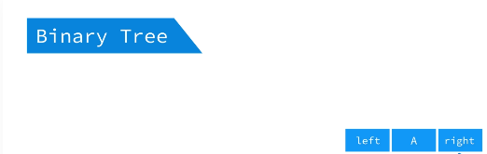


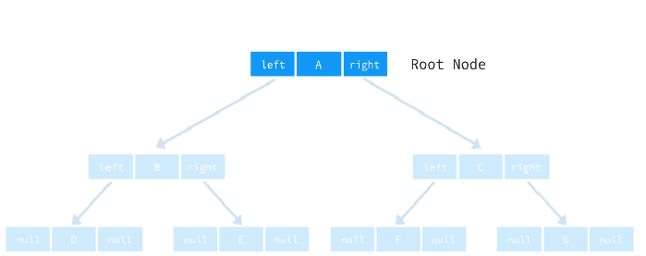
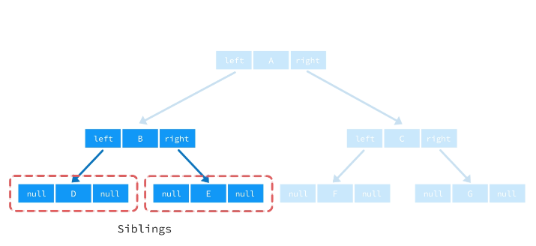
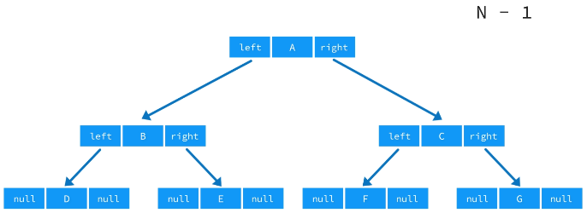
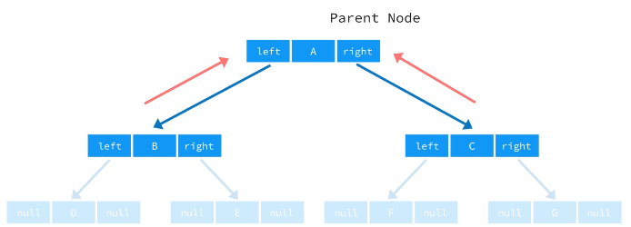
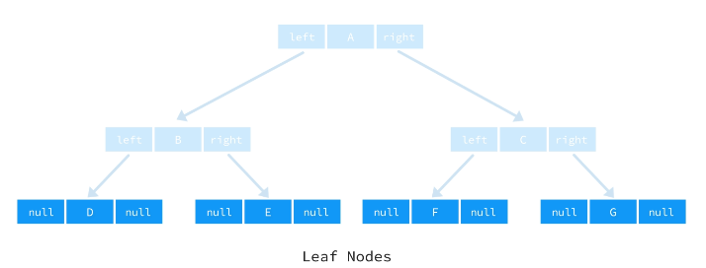

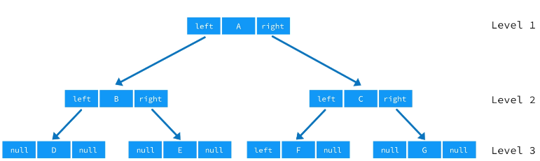
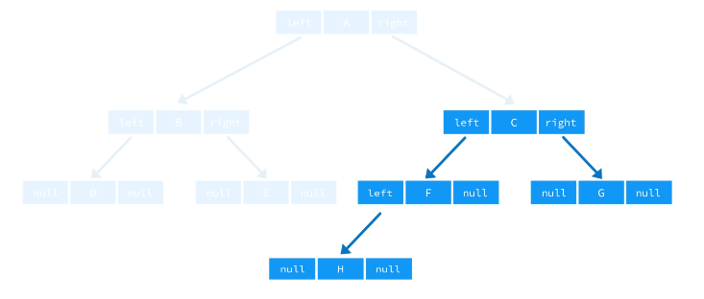
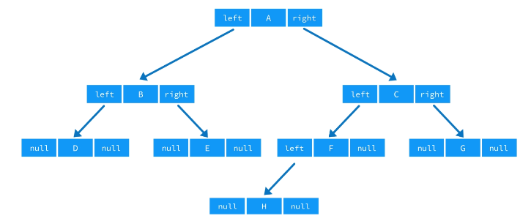
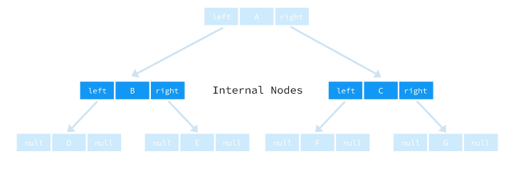
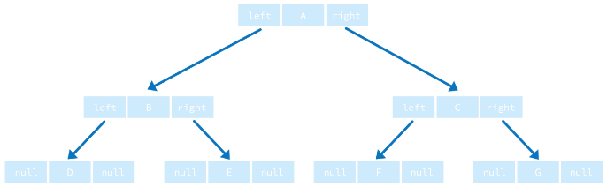
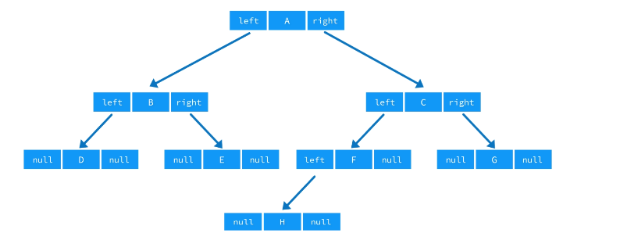
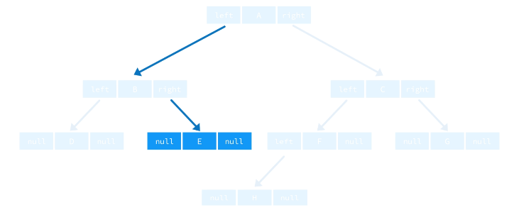
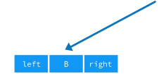
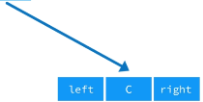





Branches
Siblings

Slide 2
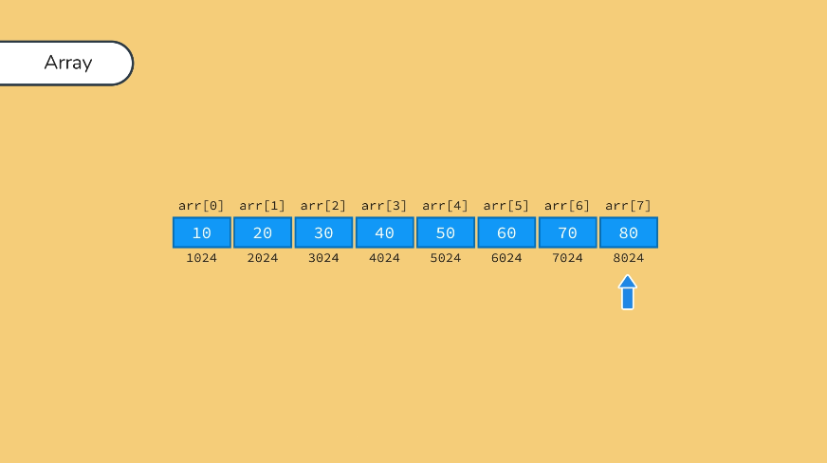
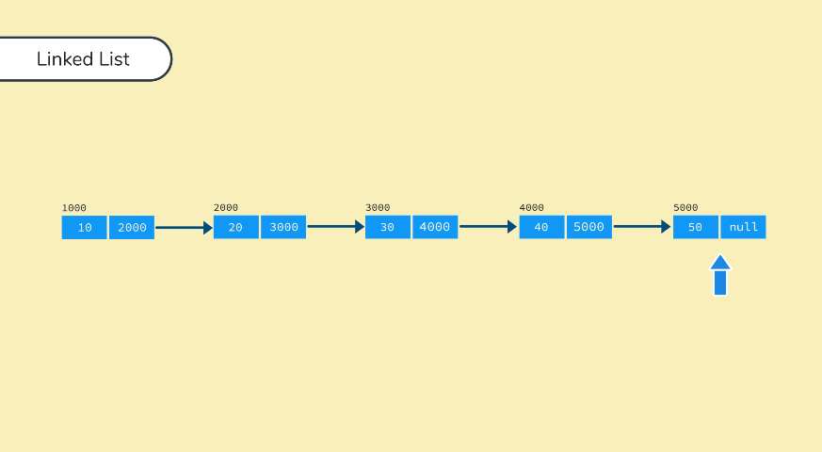
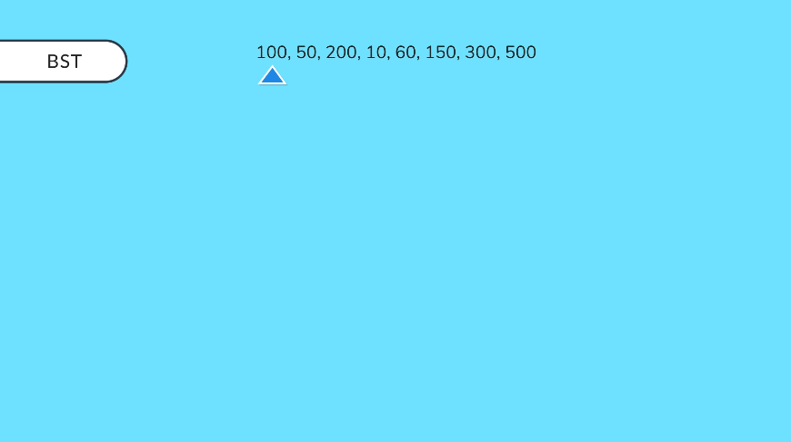
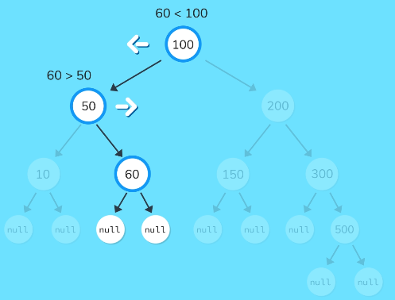
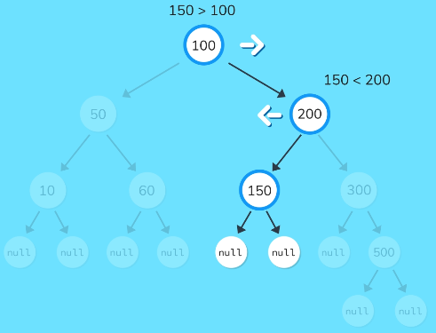
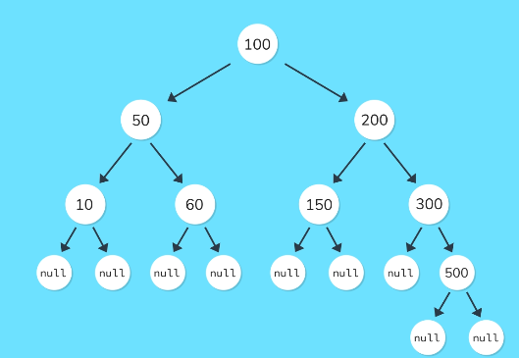
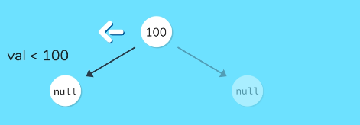
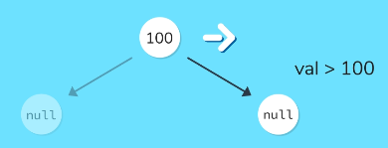
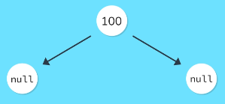


Need for binary search tree

Slide 3
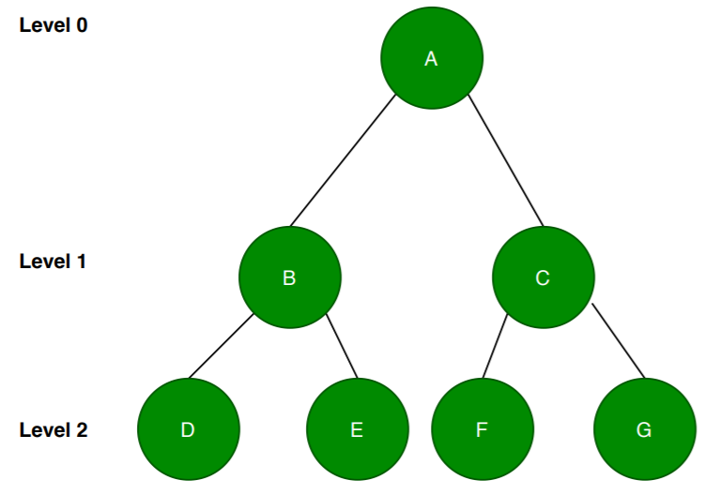
Complete binary trees/Almost complete binary trees
Full Binary Tree
A full binary tree is also known as 2-tree in which every node other than the leaf nodes has two
child nodes. It means all the leaf nodes should be at the same level and all other internal nodes
should contain two child nodes each.

Slide 4
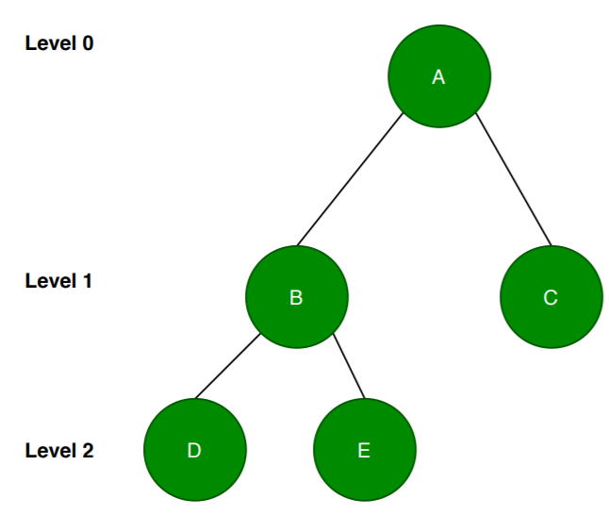
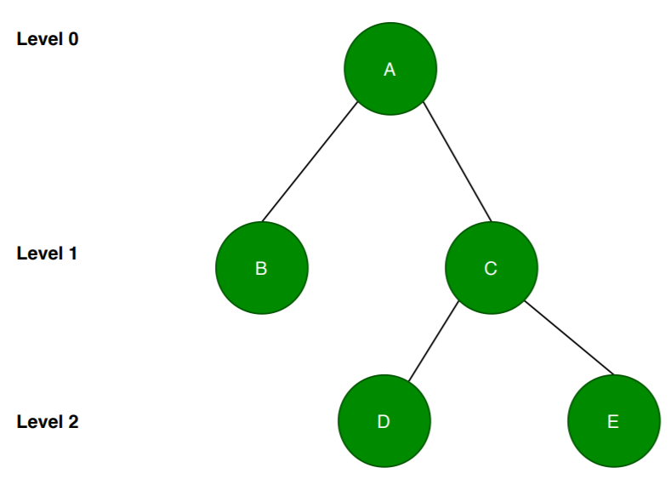
Complete Binary Tree
In a complete binary tree, all the levels of a tree are filled entirely except the last level. In the
last level, nodes might or might not be filled fully. Also, let’s note that all the nodes should
be filled from the left.

Slide 5
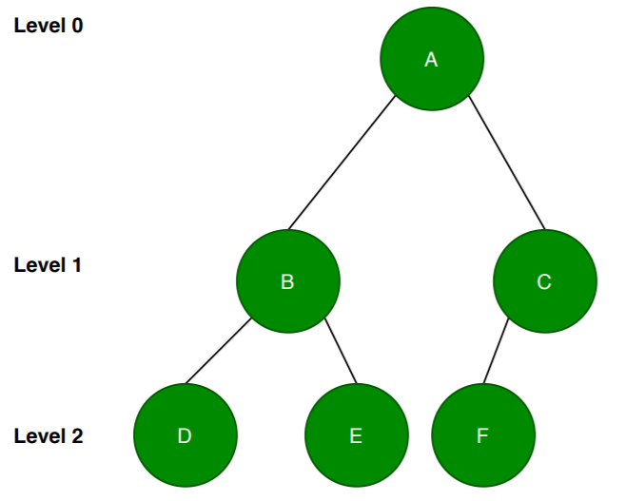
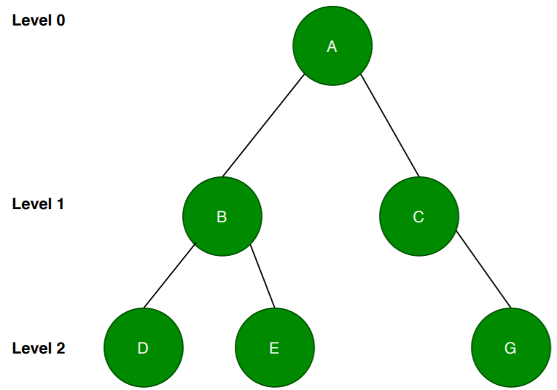
Almost Complete Binary Tree(ACBT)
An almost complete binary tree is a special kind of binary tree where insertion takes place level by level and from left to right order at each level and the last level is not filled fully always.

Slide 6
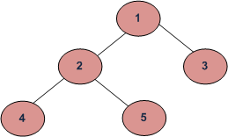
Binary Tree Traversal
Traversing a tree means accessing every node of tree once. There are 3 ways for traversing
a binary tree and they all are the part of Depth First Search(DFS) traversal
Preorder➔ (Root—Left sub tree---Right sub tree)
Inorder➔ (Left sub tree---Root---Right sub tree)
Postorder ➔(Left sub tree---Right sub tree--Root)

Slide 7
Preorder Binary Tree Traversal
Algorithm
Process the root R
Traverse the left sub tree of R in preorder
Traverse the right sub tree of R in preorder
1 2 4 5 3

Slide 8
Inorder Binary Tree Traversal
Algorithm
Traverse the left sub tree of R in inorder
Process the root R
Traverse the right sub tree of R in inorder
4 2 5 1 3

Slide 9
Postorder Binary Tree Traversal
Algorithm
Traverse the left sub tree of R in postorder
Traverse the right sub tree of R in postorder
Process the root R
4 5 2 3 1

Slide 10
Breadth First Search (BFS)Traversal
BFS is a traversing algorithm where you should start traversing from a selected node
(source or starting node) and traverse the graph layerwise thus exploring the neighbour nodes
(nodes which are directly connected to source node). You must then move towards the
next-level neighbour nodes.
1 2 3 4 5

Slide 11
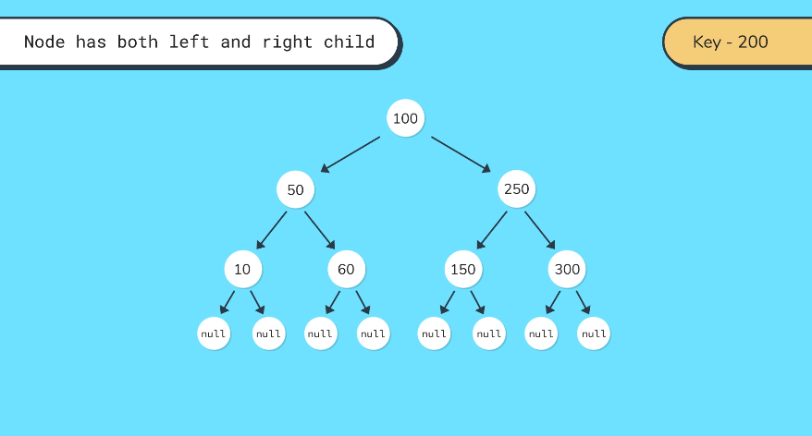
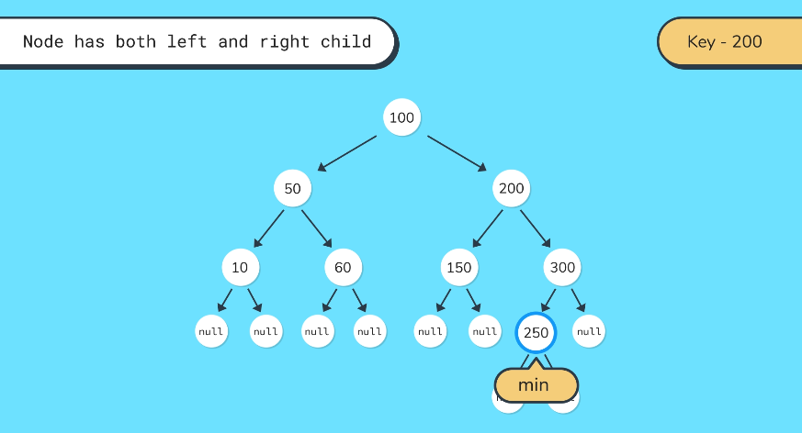
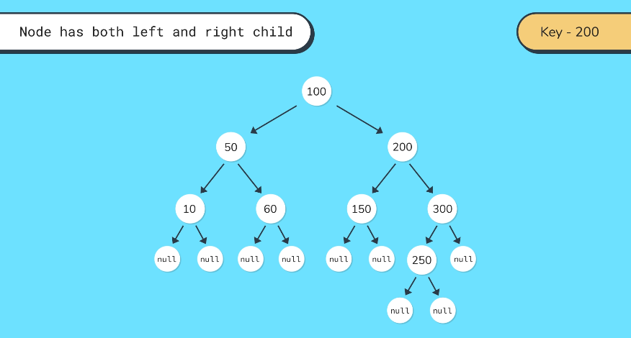
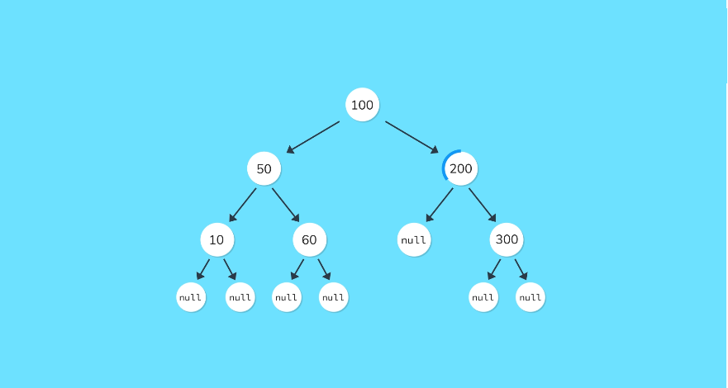
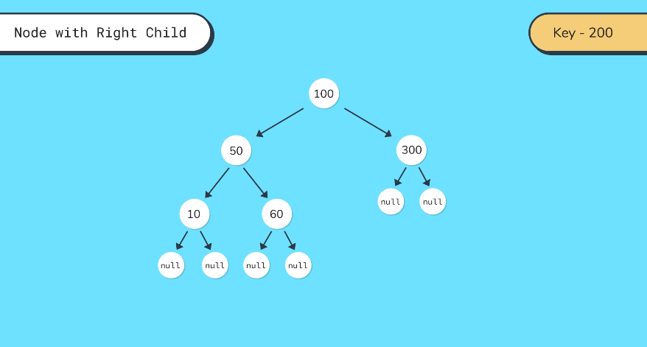
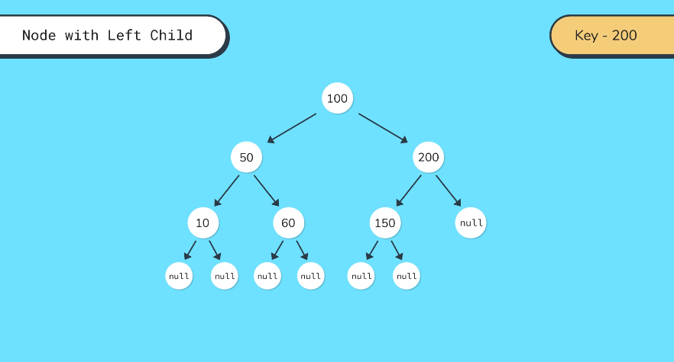
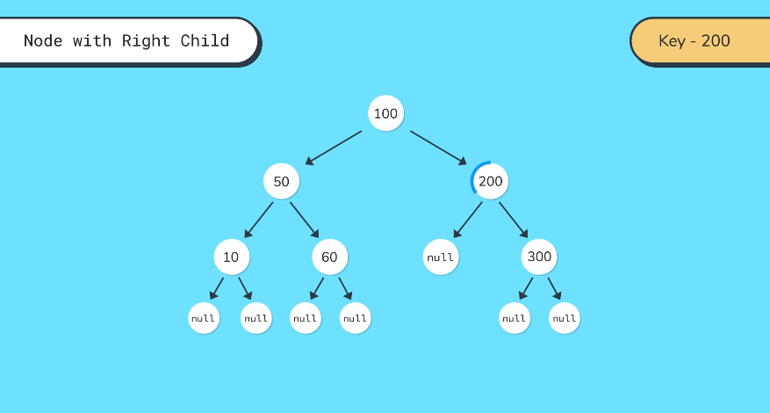
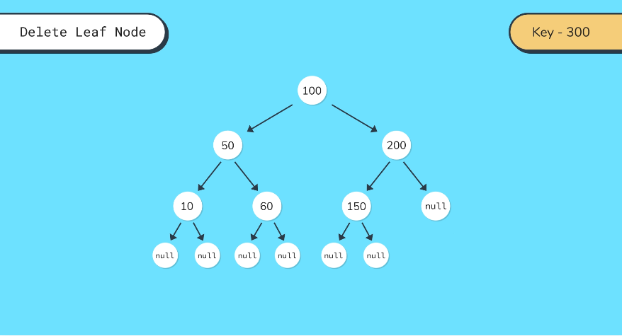
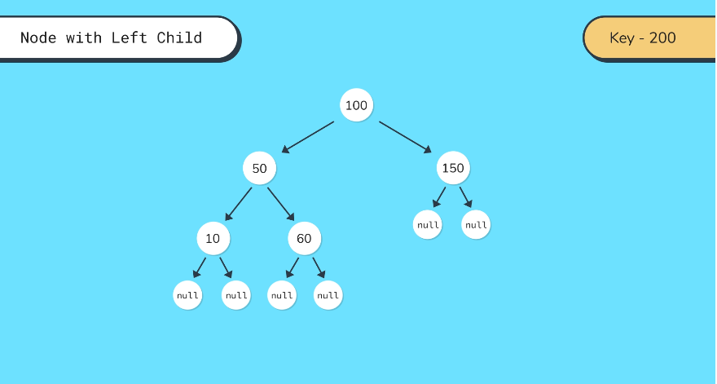
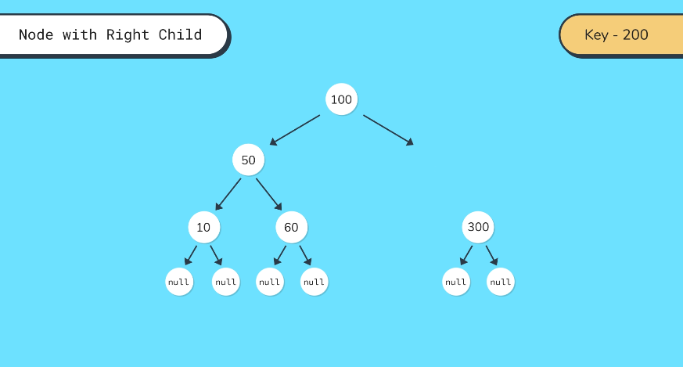
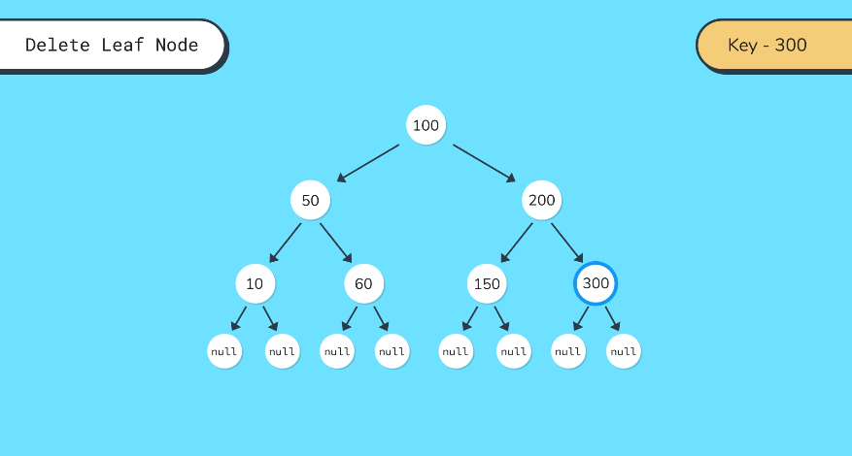
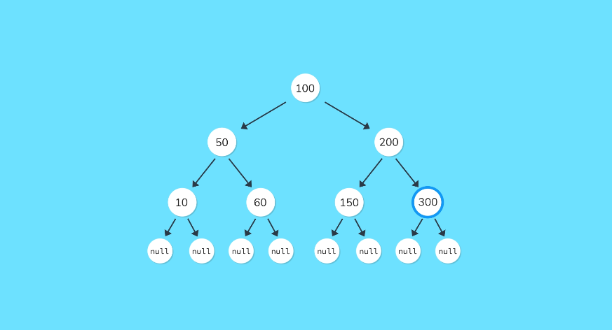
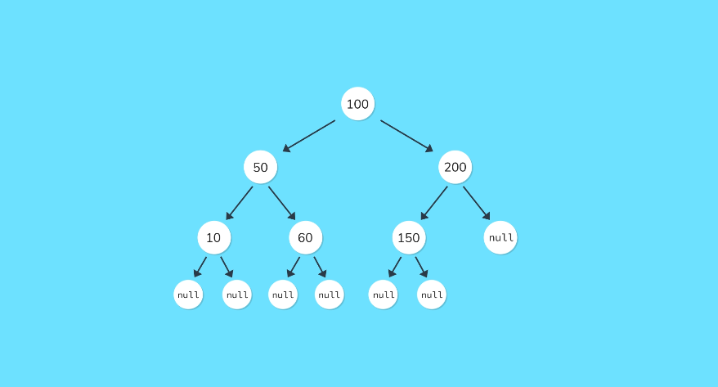
Delete a Node

Slide 12
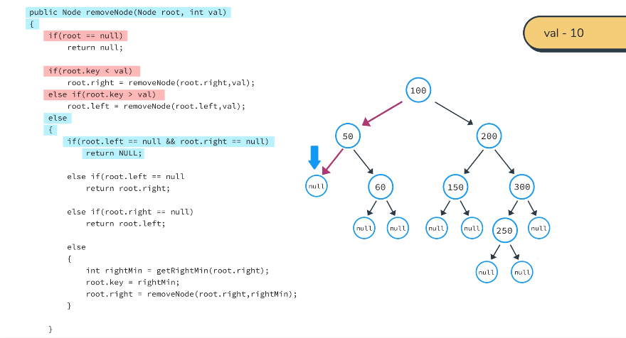
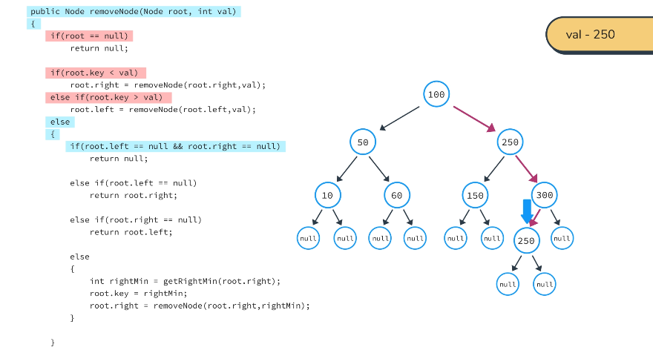
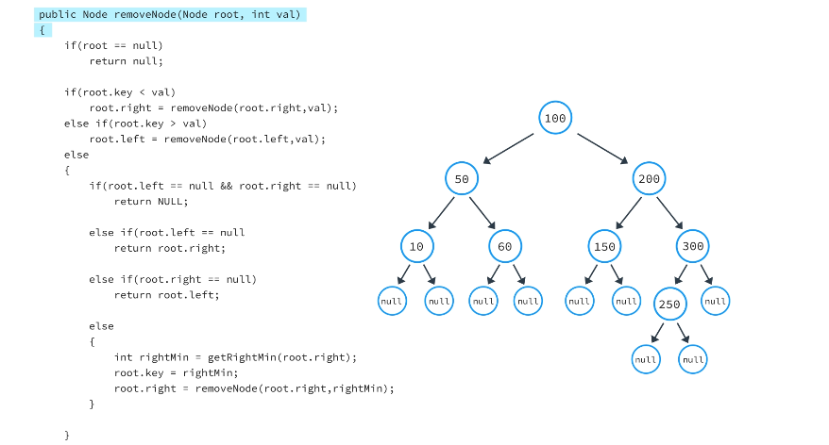
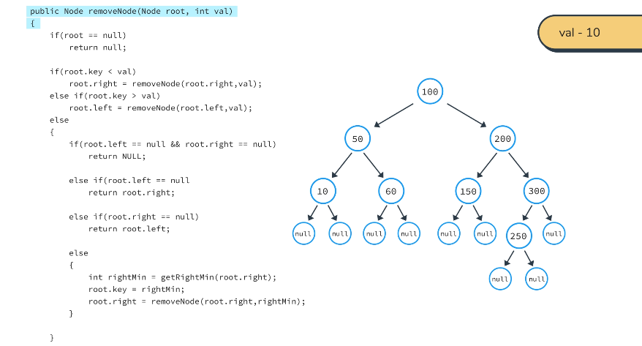
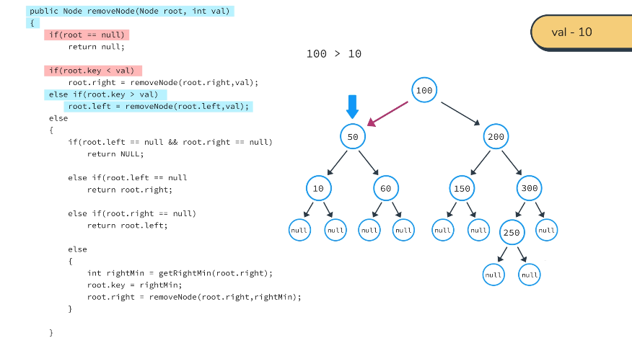
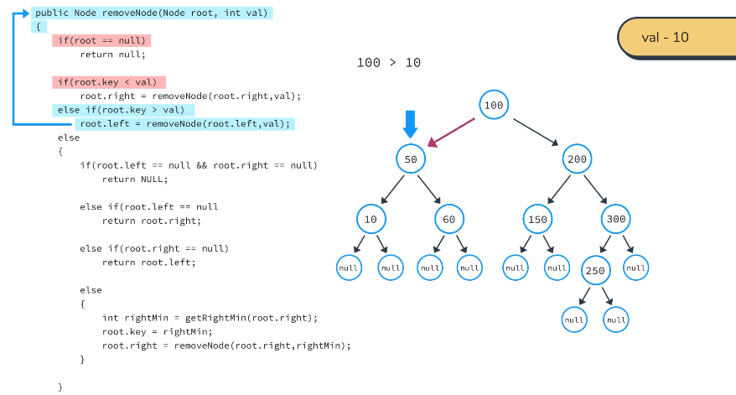
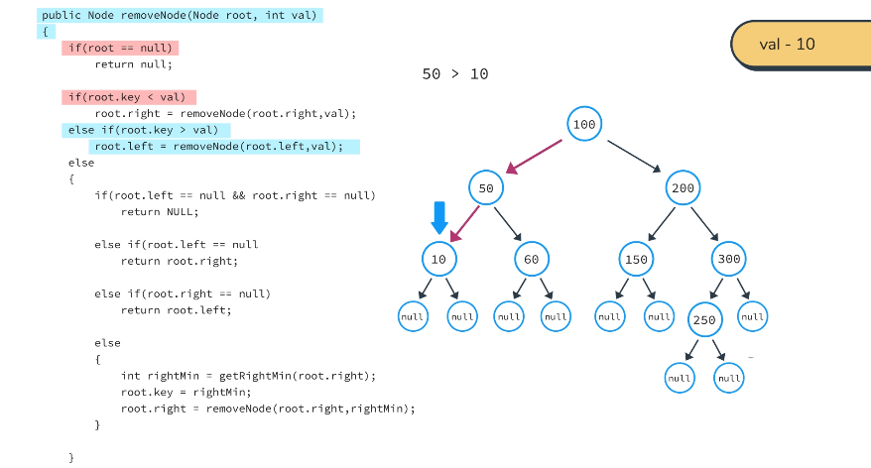












Finally Deleted

